Slide 1
Epilepsy Seizure Classification Through EEG Signals Using 1D CNN
MINOR PROJECT PRESENTATION
Under the Guidance of
Dr. Mitul Kumar Ahirwal

Slide 2

MAULANA AZAD
NATIONAL INSTITUTE OF TECHNOLOGY
BHOPAL, M.P. – 462 003 (INDIA)

Slide 3
Team Members
Satyam Singh 191112444
Mohammad Areeb 191112478
Faisal Jamil 191112476
Rishabh Pandey 191112461
CSE - 3
Group Number - 33

Slide 4
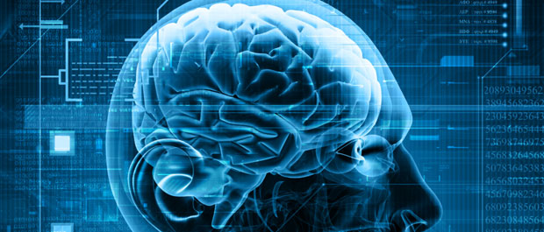
What is Epilepsy Seizure?
Seizure:
Disturbance in the electrical activity of brain.in the brain.
Fig-1: Brain Signals
Classification :
Focal
Generalized
Epilepsy:
Repeated Seizures

Slide 5
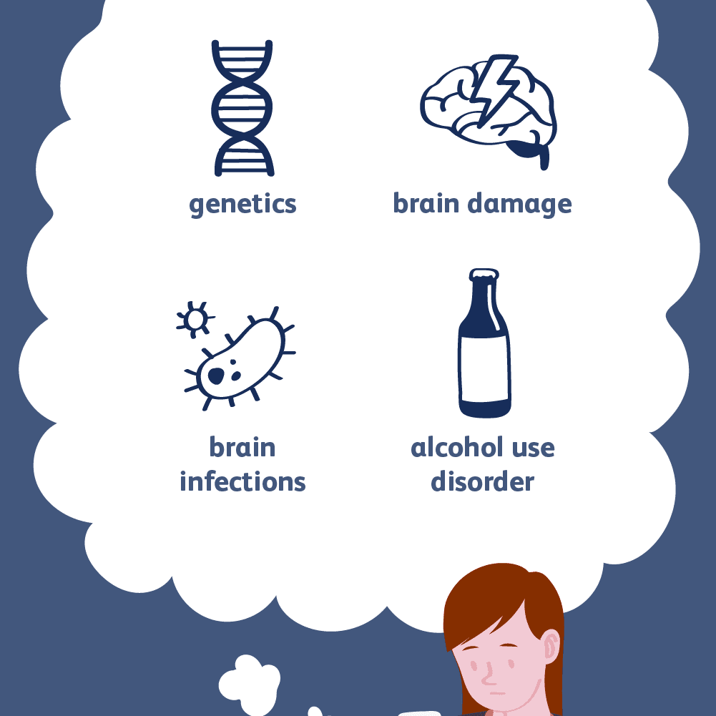
CAUSES OF EPILEPSY
Missing medication doses
Heavy alcohol use
Cocaine, ecstasy, or other illegal drugs
Lack of sleep
Other medicines that interfere with seizure medications
Flashing lights, images, and repetitive patterns may cause seizures in persons with photosensitive seizure disorder.
Trauma
Fig-2: Causes Of Epilepsy

Slide 6
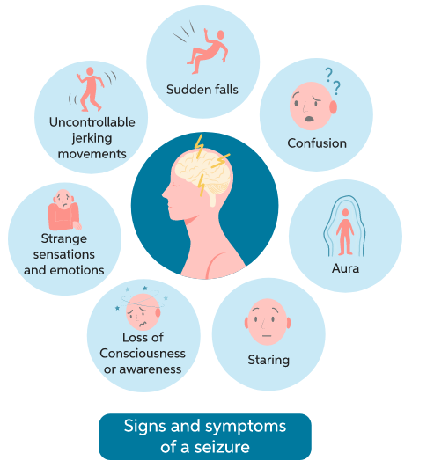
SYMPTOMS OF EPILEPSY
Loss of consciousness
Confusion
Jerking moments
Strange sensations
Sudden falls
Staring
Fig-3: Symptoms of Epilepsy

Slide 7
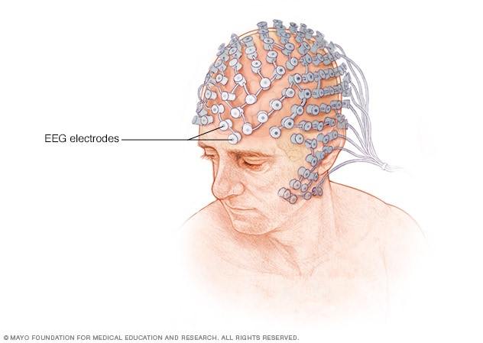
ELECTROENCEPHALOGRAPHY (EEG)
Electroencephalogram is a type of brain monitoring. It is a recording of the electrical activity of the brain by placing a small number of electrodes on your head and then measuring the electrical activity. This can be used to examine the brain and diagnose certain brain diseases, including epilepsy and seizures.
Fig-4: EEG Electrodes [7]

Slide 8
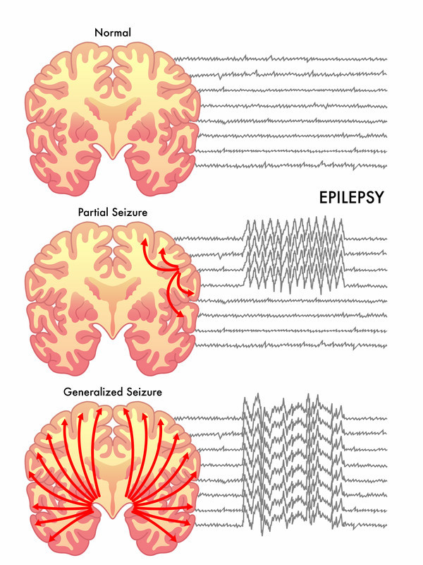
NORMAL EEG VS EEG WITH EPILEPTIC SEIZURE
Fig-5: Comparison of Normal and Abnormal EEG Signals [8]

Slide 9
DATASET
Dataset contains EEG recordings of 500 subjects.
4097 data points were measured for each subject during the interval of 23.6 seconds.
These 4097 data points are divided into 23 chunks.
Each chunk contains 178 data
points.
Sampling Frequency = 173.61 Hz
There are 5 Classes - 1,2,3,4,5
5 - Recording the EEG signal of the brain when the patient had their eyes open
4 - Recording the EEG signal when the patient had their eyes closed
3 - Recording the EEG activity from the healthy brain area
2 - Recording the EEG from the area where the tumor was located
1 - Recording of the EEG signal of a patient having seizure activity

Slide 10
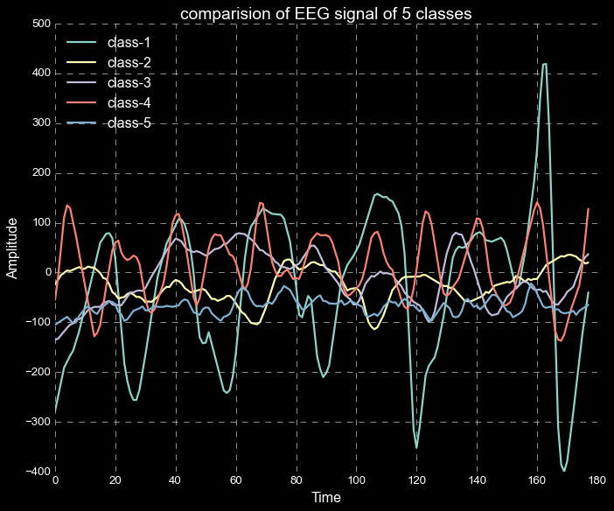
Comparison of EEG signals of all classes
Fig-6: Plot of EEG for 5 classes

Slide 11
Data Modification
All subjects falling in classes 2,3,4 and 5 are subjects who did not have epileptic seizure, only subjects in class 1 have epileptic seizure, so we have assigned label 0 for classes 2, 3, 4 and 5 and label 1 for class 1.
After binary classification we have 9200 data samples of label 0 and 2300 data samples of label 1.
Since the data is imbalance we balanced the data by using several sampling techniques.

Slide 12
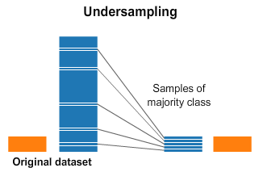
Undersampling
In this technique we balance the dataset by reducing the number of samples in the majority class.
Fig-7: Undersampling

Slide 13
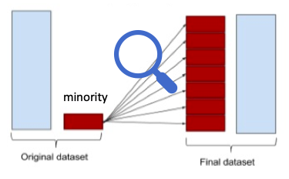
Oversampling
In this sampling method we balance the dataset by increasing the number of samples in the minority class by just creating copies of already existing samples
Fig-8: Oversampling

Slide 14
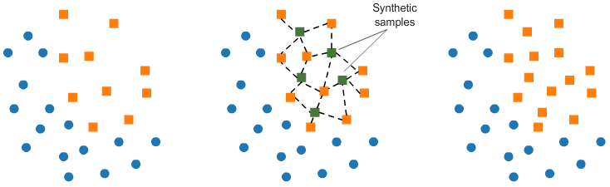
SMOTE
It’s basically an oversampling method which uses k-nearest neighbors for generating new samples in order to balance the data.
Fig-9: SMOTE

Slide 15
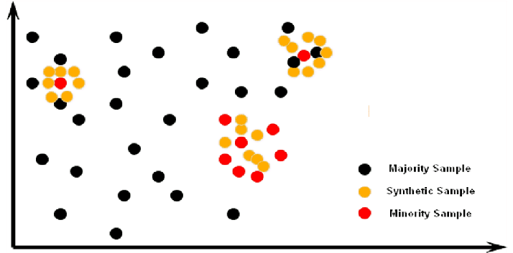
ADASYN
ADASYN or Adaptive Synthetic Sampling Approach is a sampling technique which is a generalization of SMOTE.It adjusts the decision constraints adaptively depending on difficult samples.
Fig-10: ADASYN

Slide 16
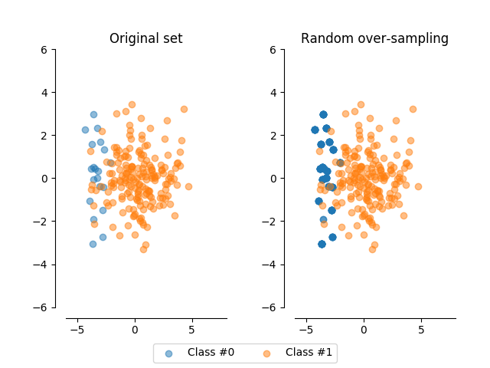
Random Oversampling
It creates duplicates by randomly selecting samples from minority class for data balancing.
Fig-11: Random Oversampling

Slide 17
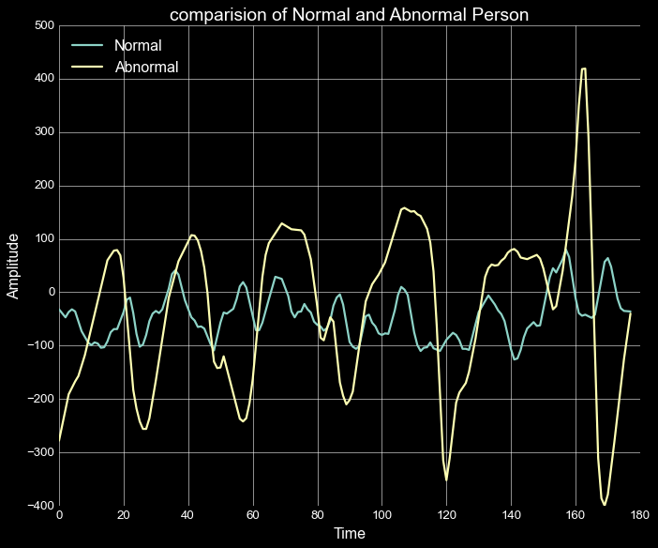
Comparison of EEG Signals
Fig-12: Comparison of EEG SIgnals

Slide 18
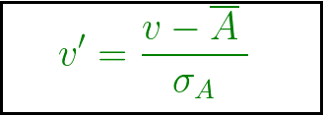
Normalisation of Data
Z-score Normalisation
In this normalisation technique every value in the dataset is normalised in such a way that the mean of all of values is zero and standard deviation is one.

Slide 19
Training, Testing and Validation Split
Training and Testing split kept at a 70:30 ratio. So,
Number of samples in train set: 12880 samples
Number of samples in test set: 5520 samples
Now we further split the training dataset into a training and validation dataset at 80:20 ratio. So,
Number of samples in train set: 10304 samples
Number of samples in validation set: 2576 samples

Slide 20
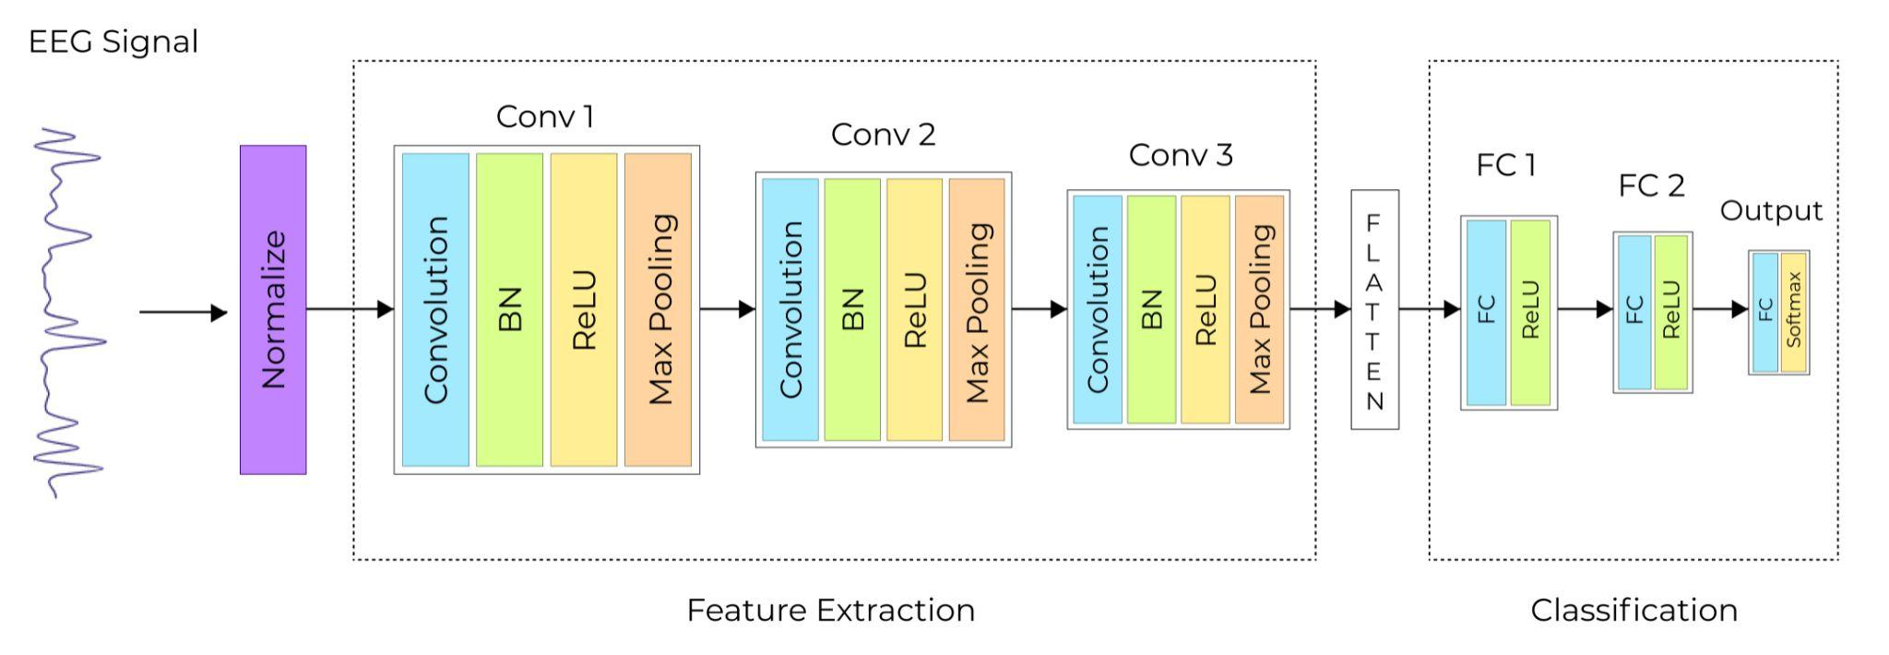
CNN ARCHITECTURE
Fig-13: CNN Architecture

Slide 21
Convolution Block
1 D Convolution layer
Batch normalisation layer
Max pooling layer
Fig-14: Convolution Block

Slide 22
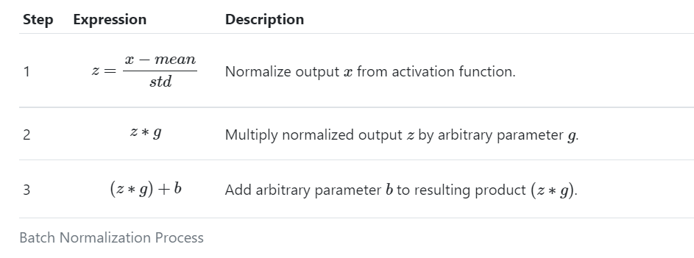
Batch Normalization
Fig-15: Batch Normalization

Slide 23
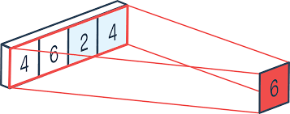
Max Pooling
Fig-16: Max Pooling

Slide 24
Relu Activation Function
Fig-17: Relu Activation Function

Slide 25
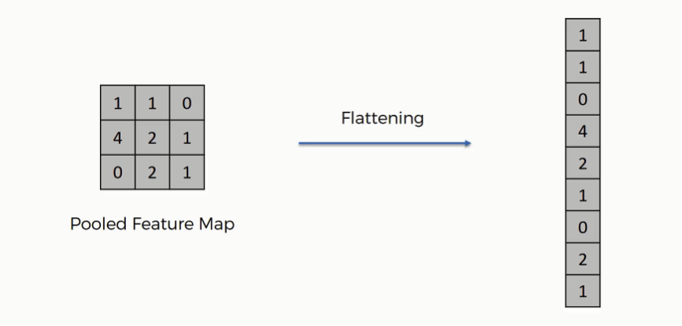
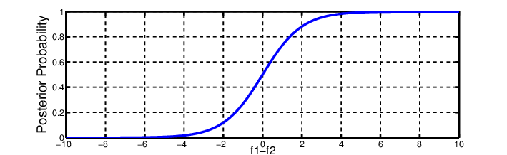
Output Block
Flatten layer
Dense layer
Output layer
Relu
Softmax
Fig-18: Output Block

Slide 26
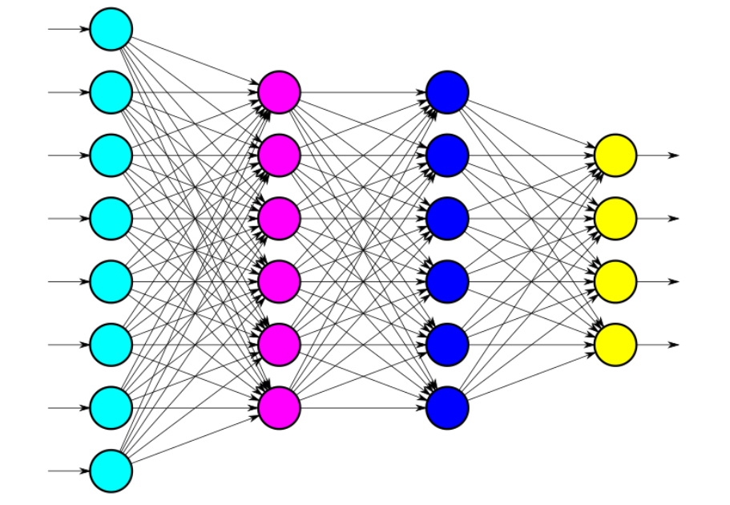
Training
Adam optimizer
Binary Cross entropy
Fig-19: Training

Slide 27
Convolutional Neural Network
1 Input layer, 3 convolutional layer, 2 hidden layers and 1 output layer.
Max-pooling layer to reduce computational cost and batch. normalisation layer for improving training and learning rate.
Relu and Softmax as Activation functions.
Adam as optimizer.
No. of epochs = 30.

Slide 28
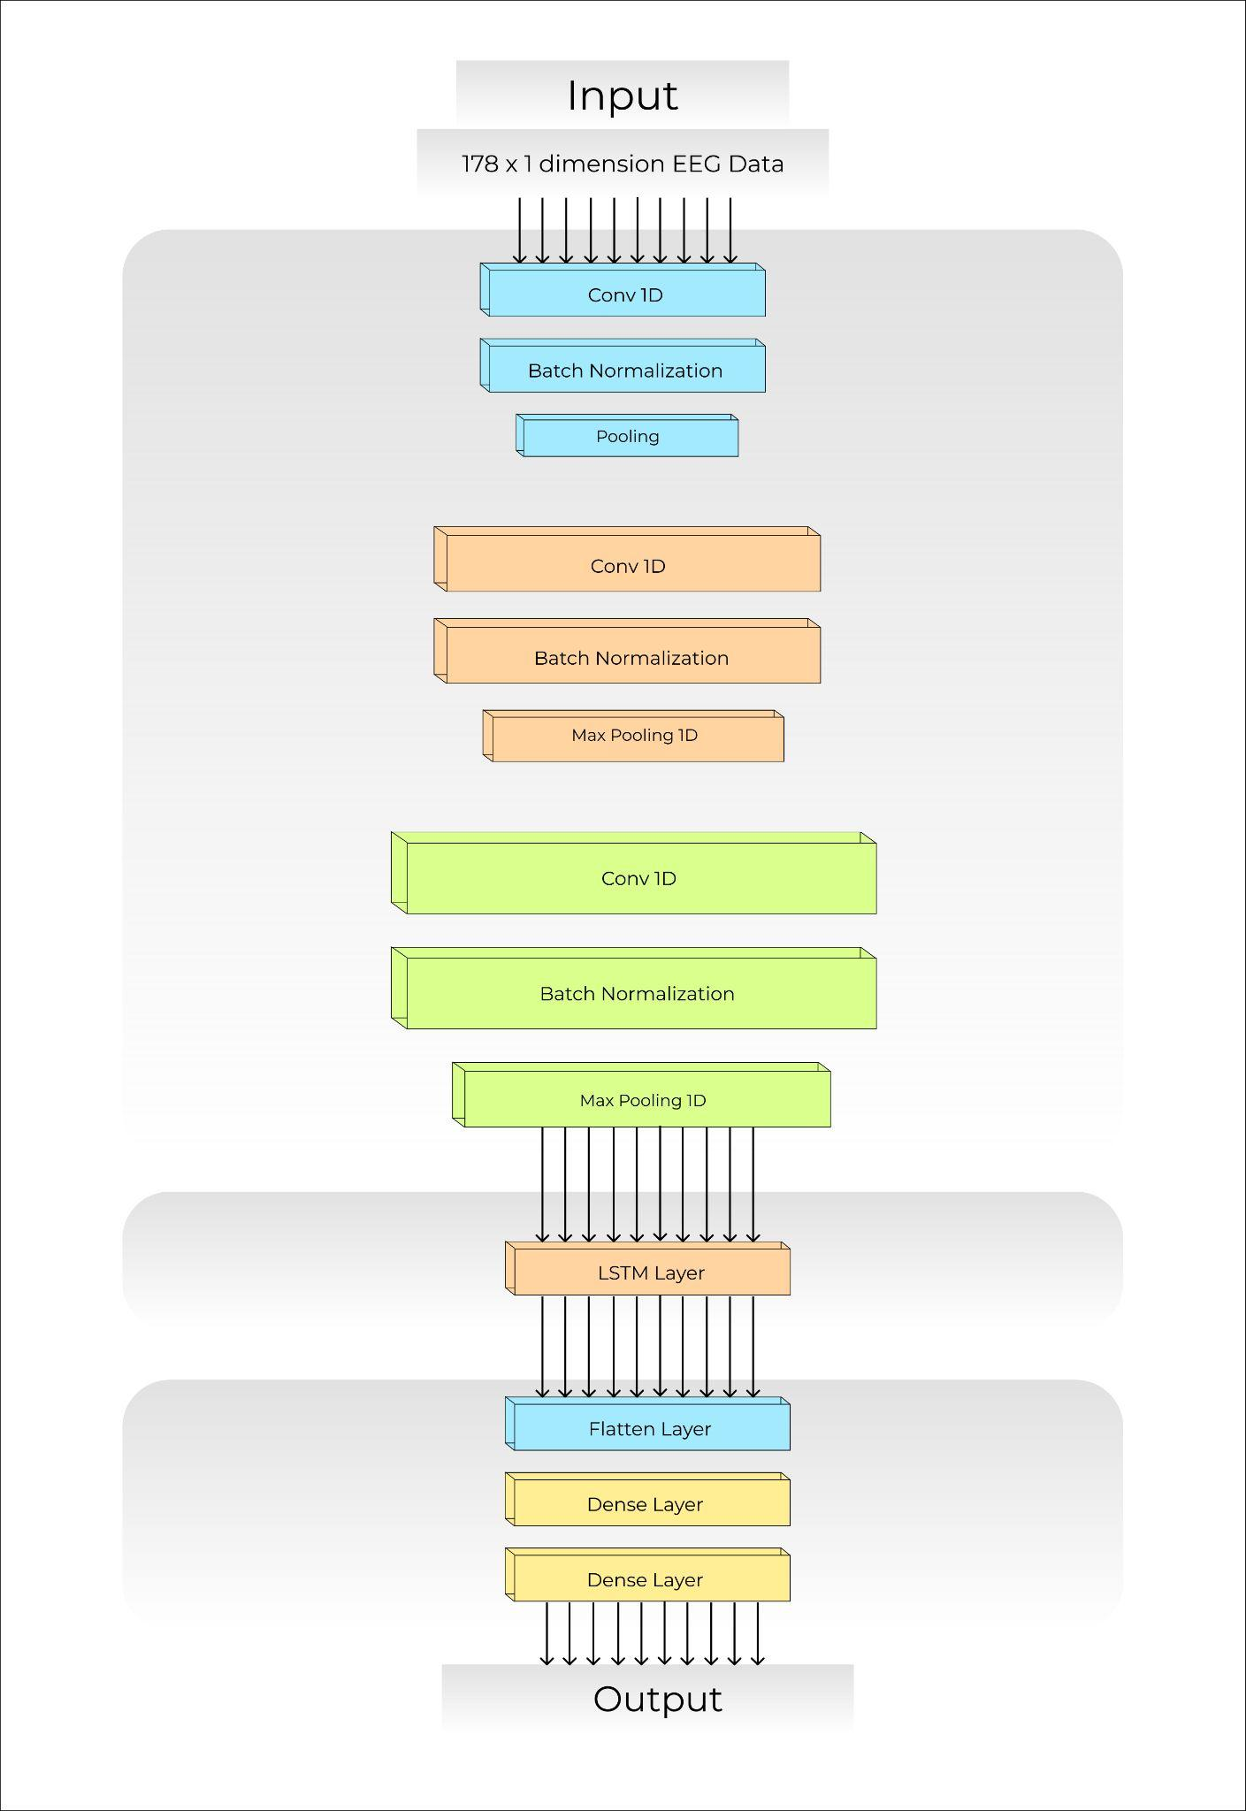
CNN + LSTM
Fig-20: CNN + LSTM Architecture

Slide 29
RNN
RNN or Recurrent Neural Networks are basically neural networks that helps in finding the pattern in sequential data like time series data but it has certain shortcomings like vanishing gradient descent and short term memory.

Slide 30
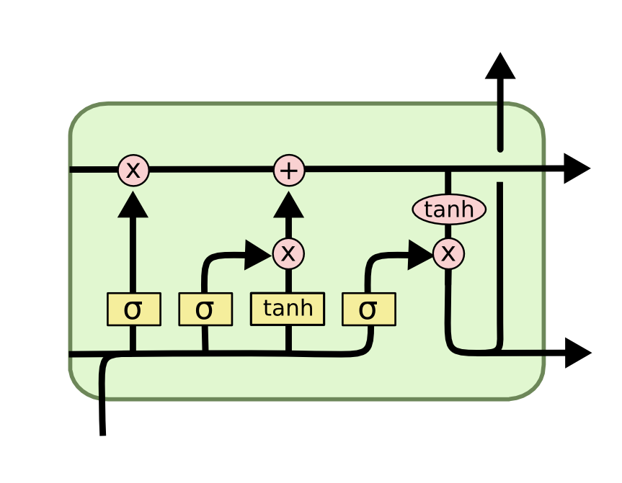
LSTM
LSTM stands for long short-term memory networks,It’s basically an extended form of RNN( Recurrent Neural Network) that overcomes the problems posed by RNN .It solves the problem of vanishing gradient and along with RNN it provides long term memory
The LSTM has three layers;
input layer
single hidden layer
feedforward output layer
Fig-21: LSTM

Slide 31
RESULTS

Slide 32
Table-1: Accuracy Table of Different Models
Classes | Model | Data Balancing Type | Training Accuracy (%) | Testing Accuracy (%)
5 | CNN | - | 98.52 | 75.50
 | CNN+LSTM | - | 98.70 | 80.75
3 | CNN | - | 99.57 | 88.69
 | CNN+LSTM | - | 99.18 | 96.05
2 | CNN | - | 99.81 | 98.81
 | CNN | Undersampling | 99.73 | 97.39
 | CNN | Oversampling | 99.73 | 99.52
 | CNN | SMOTE | 99.92 | 99.31
 | CNN | ADASYN | 99.64 | 98.19
 | CNN | Random Oversampler | 99.73 | 99.38
 | CNN | SVM SMOTE | 99.63 | 99.29
 | CNN | Borderline SMOTE | 99.91 | 99.11

Slide 33
Final Accuracy
Training Accuracy : 99.92 percent
Validation Accuracy : 99.53 percent
Testing Accuracy : 99.31 percent

Slide 34
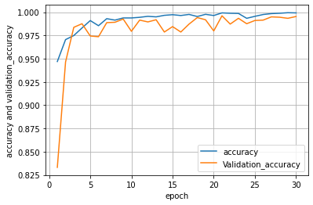
Fig-22: Training and Validation Accuracy

Slide 35
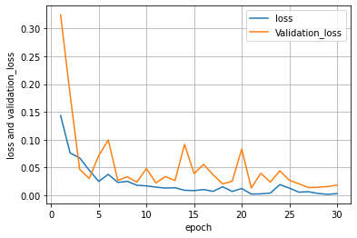
Fig-23: Training and validation loss

Slide 36
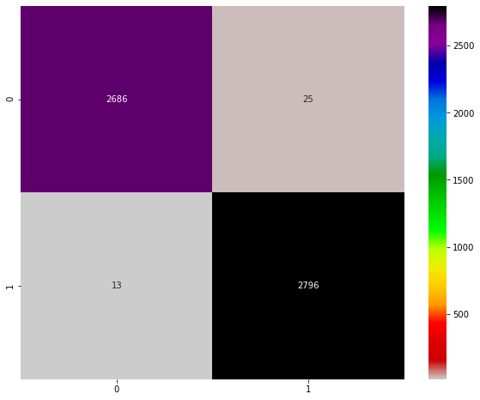
Table-2: Confusion Matrix
Binary Classification | Predicted Negative | Predicted Positive
Actual Negative | True Negative(TN) | False Positive(FP)
Actual Positive | False Negative(FN) | True Positive(TP)
Fig-24: Confusion matrix

Slide 37
Conclusion
Epilepsy remains incurable and there are measures taken to protect the patients from brain damage or physical injury in case of seizures.
Traditional methods used earlier for detecting epilepsy were time consuming and sometimes inefficient but with the introduction of deep learning algorithms, detection is much more easier, accurate and faster.
Deep learning methods allow the use of large datasets and improved detection accuracy than human counterparts.
With 1-D CNN architecture, we got an accuracy of 99.31 percent for detecting epileptic seizure.

Slide 38
References
Abiyev, Rahib, et al. "Identification of epileptic EEG signals using convolutional neural networks." Applied Sciences 10.12 (2020): 4089.
Ullah, Ihsan, Muhammad Hussain, and Hatim Aboalsamh. "An automated system for epilepsy detection using EEG brain signals based on deep learning approach." Expert Systems with Applications 107 (2018): 61-71.
Fürbass, Franz. EEG monitoring based on automatic detection of seizures and repetitive discharges. Diss. Wien, 2018.
Shoeibi, Afshin, et al. "Epileptic Seizures Detection Using Deep Learning Techniques: A Review." International Journal of Environmental Research and Public Health 18.11 (2021): 5780.
Andrzejak, Ralph G., et al. "Indications of nonlinear deterministic and finite-dimensional structures in time series of brain electrical activity: Dependence on recording region and brain state." Physical Review E 64.6 (2001): 061907.
Kiranyaz, Serkan, et al. "1D convolutional neural networks and applications: A survey." Mechanical systems and signal processing 151 (2021): 107398.
Mayo Foundation for Medical Education and Research (MFMER)
Harvard Health Publishing, Harvard Medical School

Slide 39


